Slide 1
Building Document Structure
XHTML

Slide 2
Objectives
In this chapter, you will:
Learn how to create Extensible Hypertext Markup Language (XHTML) documents
Study XHTML elements and attributes
Learn about required XHTML elements
Study basic XHTML elements
XHTML

Slide 3
Block-Level and Inline Elements
Two basic types of elements can appear within a document’s <body> element: block-level and inline
  Block-level elements are elements that give a Web page its structure
  Inline, or text-level, elements describe the text that appears on a Web page
  Unlike block-level elements, inline elements do not appear on their own lines; they appear within the line of the block-level element that contains them
XHTML

Slide 4
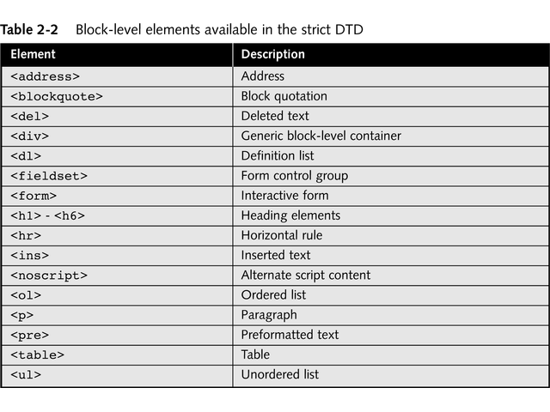
Block-Level and Inline Elements
XHTML

Slide 5
Standard Attributes
You place attributes before the closing bracket of the starting tag, and you separate them from the tag name or other attributes with a space
Many XHTML attributes are unique to a specific element or can only be used with certain types of elements
XHTML also includes several standard, or common, attributes that are available to almost every element, with a few exceptions
XHTML

Slide 6
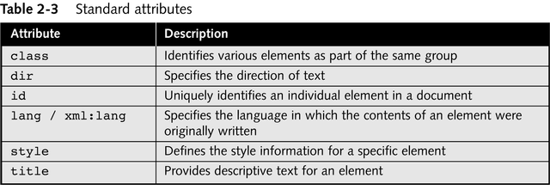
Standard Attributes
XHTML

Slide 7
Standard Attributes
In order to be a considerate resident of the international world of the Web, you should designate the language of your elements using the lang and xml:lang attributes
The lang attribute is used in HTML documents, whereas the xml:lang attribute is used in XML-based documents
XHTML

Slide 8
Boolean Attributes
A Boolean attribute specifies one of two values: true or false
The presence of a Boolean attribute in an element’s opening tag indicates a value of “true”, whereas its absence indicates a value of “false”
When a Boolean attribute is not assigned a value, it is referred to as having a minimized form
Recall that all attribute values must appear within quotation marks
XHTML

Slide 9
Boolean Attributes
This syntax also means that an attribute must be assigned a value
  For this reason, minimized Boolean attributes are illegal in XHTML
You can still use Boolean attributes in XHTML provided you use their full form
You create the full form of a Boolean attribute by assigning the name of the other attribute itself as the attribute’s value
XHTML

Slide 10
Required Elements
To better understand how an XHTML document is structured, in this section you study in detail the three elements that must be included in every XHTML document: the <html>, <head>, and <body> elements
XHTML

Slide 11
The <html> Element
All HTML documents must include an <html> element, which tells a Web browser that the instructions between the opening and closing <html> tags are to be assembled into an HTML document
The <html> element is required and contains all the text and other elements that make up the HTML document
The <html> element is also the root element for XHTML documents and is required for XHTML documents to be well formed
XHTML

Slide 12
The XHTML Namespace
All of the predefined elements in an XHTML document are organized within the XHTML namespace that you declare in the <html> element
In order to understand what a namespace is, recall that you must define your own elements and attributes in an XML document
You identify each element by the namespace to which it belongs
A namespace organizes the elements and attributes of an XML document into separate groups
XHTML

Slide 13
The XHTML Namespace
For elements, you add the namespace and colon before the tag name in both the opening and closing tags
A default namespace is applied to all of the elements and attributes in an XHTML document, with the exception of elements and attributes to which local namespaces have been applied
You specify a default namespace for an XHTML document by using the xmlns namespace attribute in the <html> element
XHTML

Slide 14
The Document Head
The elements within a document’s head section contain information about the Web page itself
The document head does not actually display any information in a browser
  Rather, it is a parent element that can contain several child elements
A parent element is an element that contains other elements, known as child elements
XHTML

Slide 15
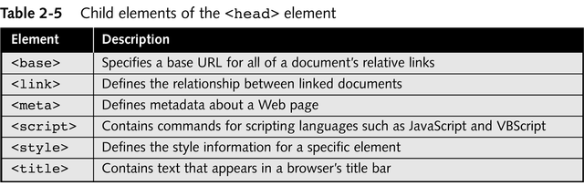
Child Elements of the <head> Element
XHTML

Slide 16
The Document Body
The document body is represented by the <body> element and contains other elements that define all of the content a user sees rendered in a browser
XHTML documents consist of elements that contain content, as opposed to HTML documents, which consist of content that contains elements
In HTML, you can also use various attributes in the <body> element that affect the appearance of the document, such as the bgcolor attribute for setting the background color and the text attribute for setting the default color of text
XHTML

Slide 17
Basic Body Elements
Basic body elements such as the <p> and <br /> elements are some of the most frequently used elements in Web page authoring
XHTML

Slide 18
Headings
Heading elements are used for emphasizing a document’s headings and subheadings, which helps provide structure by hierarchically organizing a document’s content
There are six heading elements, <h1> through <h6>
XHTML

Slide 19
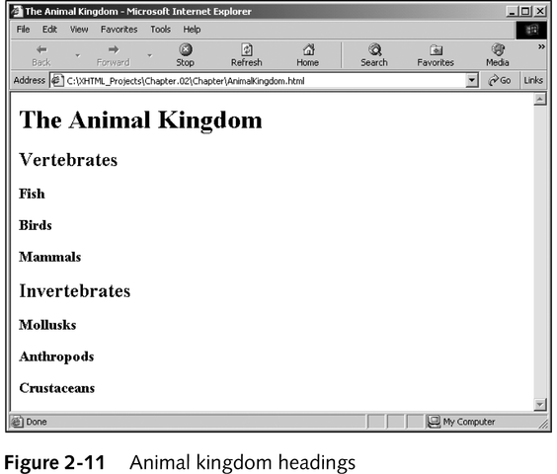
Animal Kingdom Headings
XHTML

Slide 20
Paragraphs and Line Breaks
The paragraph (<p>) and line-break (<br />) elements provide the simplest way of adding white space to a document
White space refers to the empty areas on a page
  It makes a page easier to read and is more visually appealing
  It is tempting for beginning Web page authors to try and pack each page with as much information as possible, but experienced Web page authors know that the presence of white space is critical to the success of a page, whether you are creating a Web page or a traditional printed page
XHTML

Slide 21
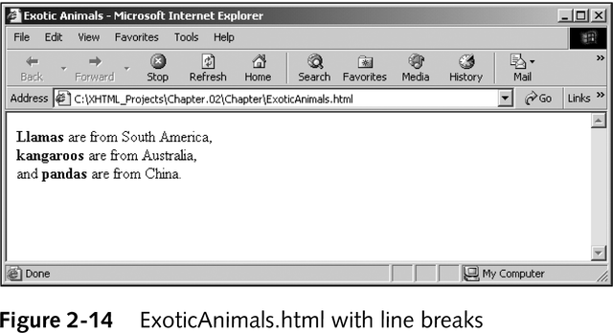
Paragraphs and Line Breaks
XHTML

Slide 22
Horizontal Rules
The empty horizontal-rule (<hr />) element draws a horizontal rule on a Web page that acts as a section divider
Horizontal rules are useful visual elements for breaking up long documents
Although the <hr /> element is technically a block-level element, it cannot contain any content because it is an empty element
XHTML

Slide 23
Comments
Comments are nonprinting lines that you place in your code to contain various types of remarks, including your name and the date you wrote the code, notes to yourself, copyright information, or instructions to future Web page authors and developers who may need to modify your work
XHTML comments begin with an opening comment tag <!– and end with a closing comment tag -->
XHTML

Slide 24
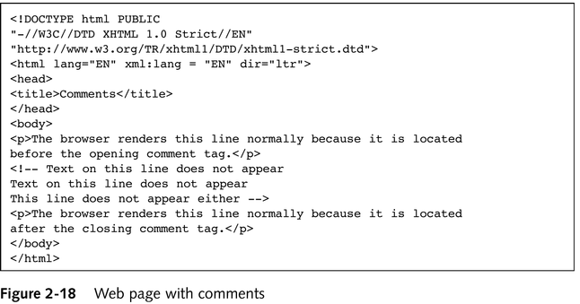
Web Page with Comments
XHTML

Slide 25
Summary
The <!DOCTYPE> declaration states the Extensible Hypertext Markup Language (XHTML) version of the document and the XHTML Document Type Definitions (DTD) with which the document complies
Elements and attributes that are considered to be obsolete and that will eventually be eliminated are said to be deprecated
The Transitional DTD allows you to continue using deprecated elements along with the well-formed document requirements of Extensible Markup Language (XML)
XHTML

Slide 26
Summary
The Frameset DTD is identical to the Transitional DTD, except that it includes the <frameset> and <frame> elements, which allow you to split the browser window into two or more frames
The Strict DTD eliminates the elements that were deprecated in the Transitional DTD and Frameset DTD
Validation checks that your XHTML document is well formed and that the elements in your document are correctly written according to the element definitions in an associated DTD
XHTML

Slide 27
Summary
All XHTML documents, regardless of whether they use the Transitional, Strict, or Frameset DTD, use the namespace identified by the following URI: http://www.w3.org/1999/xhtml
A parent element refers to an element that contains other elements, known as child elements
The horizontal rule (<hr />) element draws a horizontal rule on a Web page that acts as a section divider
XHTML

